Slide 1
Class Project
Jeremy Bergmann - Omaha Data Science Academy

Slide 2
Purpose
To create an end-product that’s similar to what would be produced in a business environment, utilizing the knowledge gained in this course.
Steps – Data Science (CRISP-DM) Process
Understand Business Problem (What should you solve for?)
Understand Data
Prepare Data
Build Model/Data Flow
Test/Evaluate Process
Deployment - Answer business questions, Generate additional questions

Slide 3
Project Milestones
Select NLP Model & Search for data (Class 2)
Utilize Scikit Learn to explore, (Class 3)
Normalize data & Create Data Model (Class 4)
Analyze Data Quality & Create Data Dictionary (Class 5)
Automate data workflow using ETL, Python or Dataiku, Connect schema to Google Data Studio (Class 6)
Ask questions/finish project for professional portfolio (Class 7/8)

Slide 4
Resources & Recommendations
Recommendations
Find some data that interests you.
Practice importing it into Workbench and cleaning it
Document the process with git and sync with your GitHub account

Slide 5
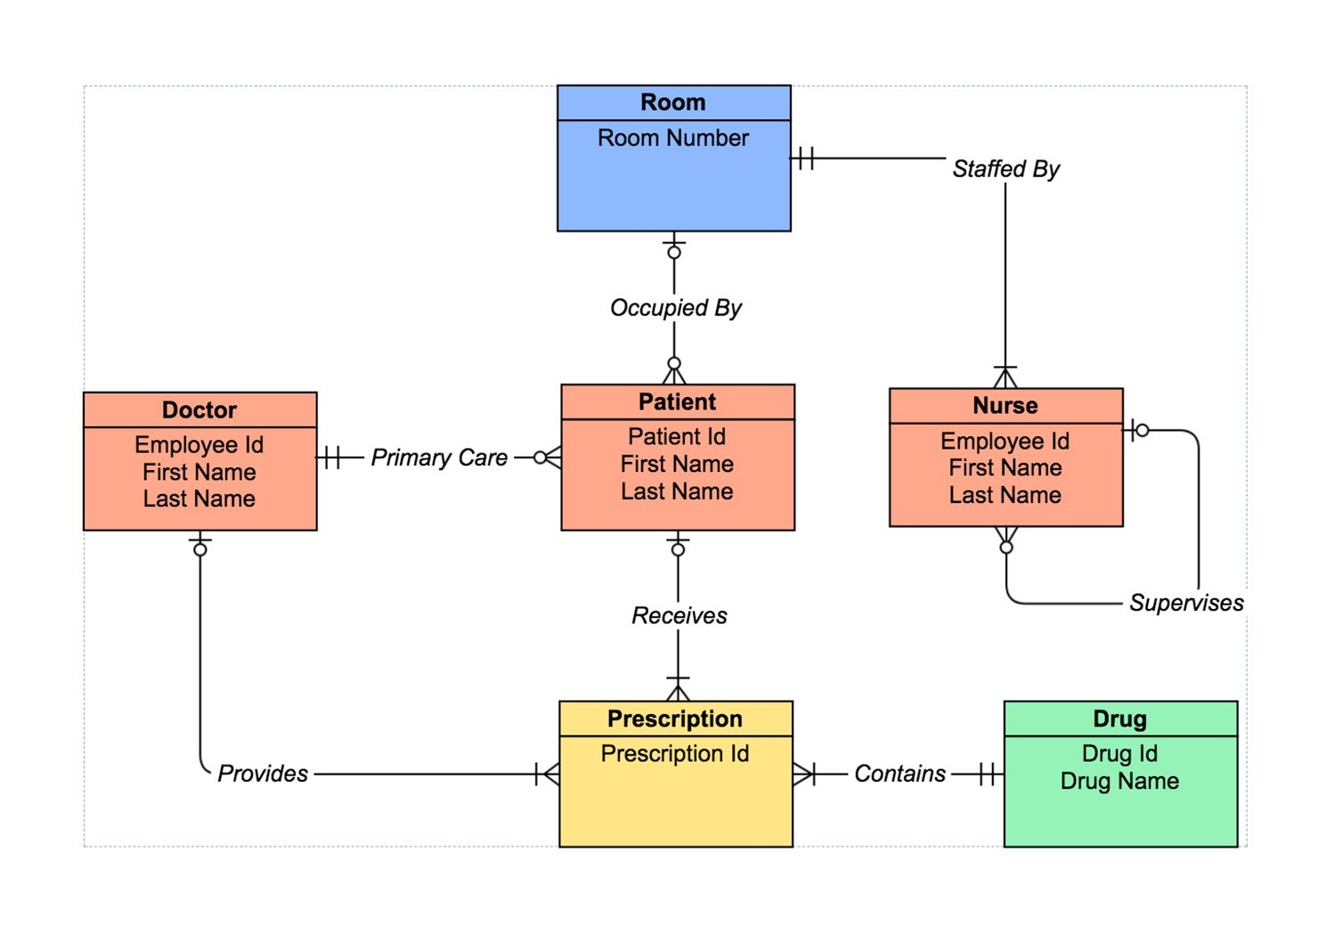
Project Data Sets - Examples
Hospital Entities
Examples
Euro 2012 data (.sql)
Consumer complaints data (.csv)
Veterinary clinic data (.csv)
Pets
Owners
Procedures history
Procedures details
Console data (.csv)
Game sales
Console dates
Notes:
Obj: 9, 10, 11
Recall the objective of learning and using SQL: ask and answer relevant questions
Map DBs, practice joins, extract dates

Slide 6
Rubric
 | Sufficient
Documentation | Comments clarify complex code. Object names are intuitive. Code is easy to read.
Problem Formulation | Questions are relevant and answerable by the available data. Answers enable a decision by an interested party.
Database Design* | All tables adhere to 1NF. All tables are connected to at least one table. Database schema adheres to an appropriate schema.
Data Cleanliness | Data adhere to appropriate data types. Data is clean.
Code Optimization | SQL code optimized for storage or performance.
Database Creation | Tables have appropriate constraints.

